Slide 1



Shoot Aliens Game
Present by:
Sarvesh Mishra

Slide 2


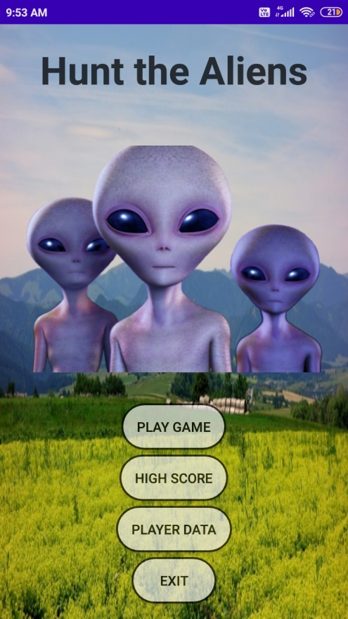
Shoot Aliens Game
Salient Features:
Material Design
No Navigation Bar Style
Game is optimized for both Portrait and Landscape Mode.
Custom App Icon
Toast Message
Dialog Box
Popup Window
Full Screen Mode during Play Time
Array Adapter is used to populate the Custom List View. (Thus eliminating the need of View Holder used in Base Adapter)
Motion Sensor

Slide 3
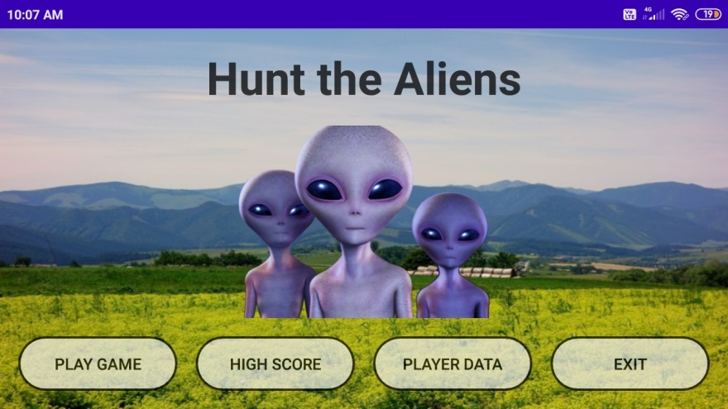
Material Design
Note how the buttons adjust in different orientations.
They also change color on being touched.

Slide 4
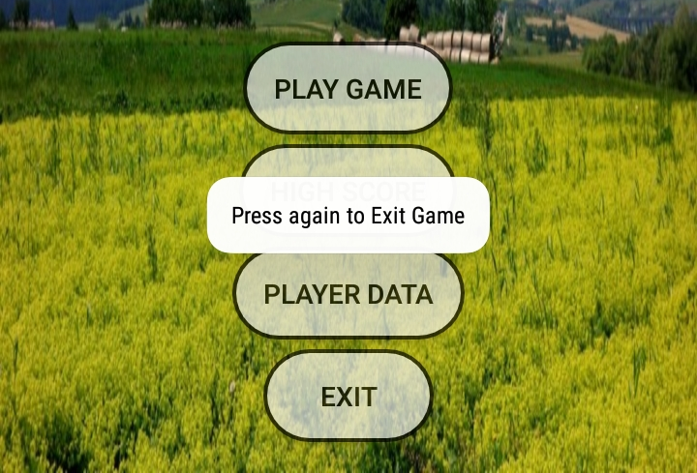
Toast Message
Toast Message when Back Button is pressed on Home Page.

Slide 5
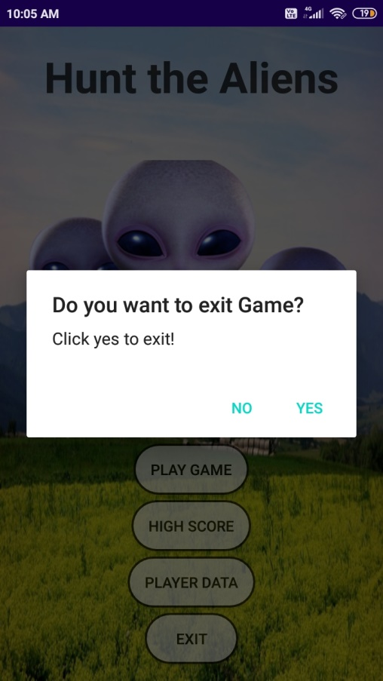
Dialog Box
Dialog Box when the user presses the EXIT button.

Slide 6
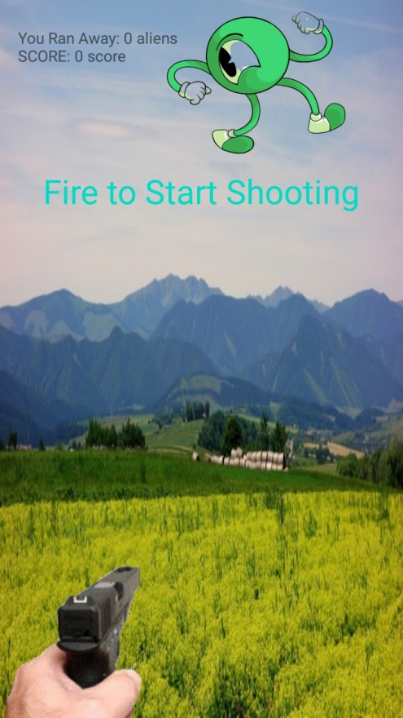
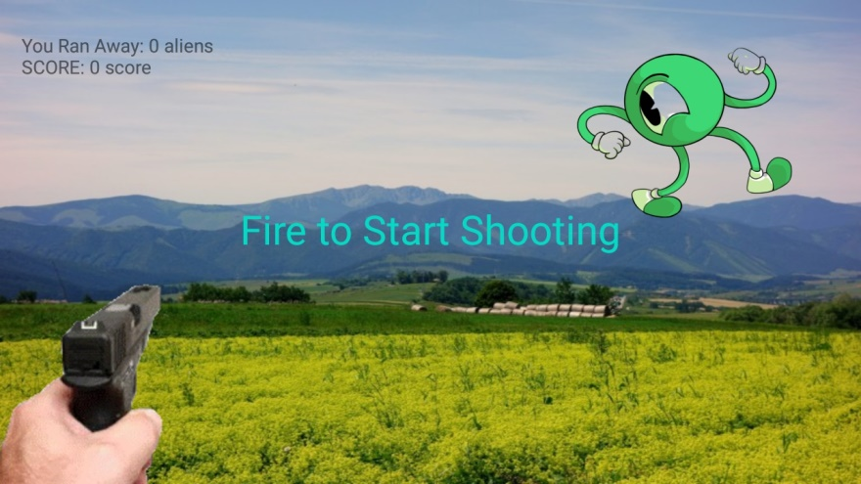
Full Screen Mode
Navigation Panel is hidden during play time for better user experience.

Slide 7
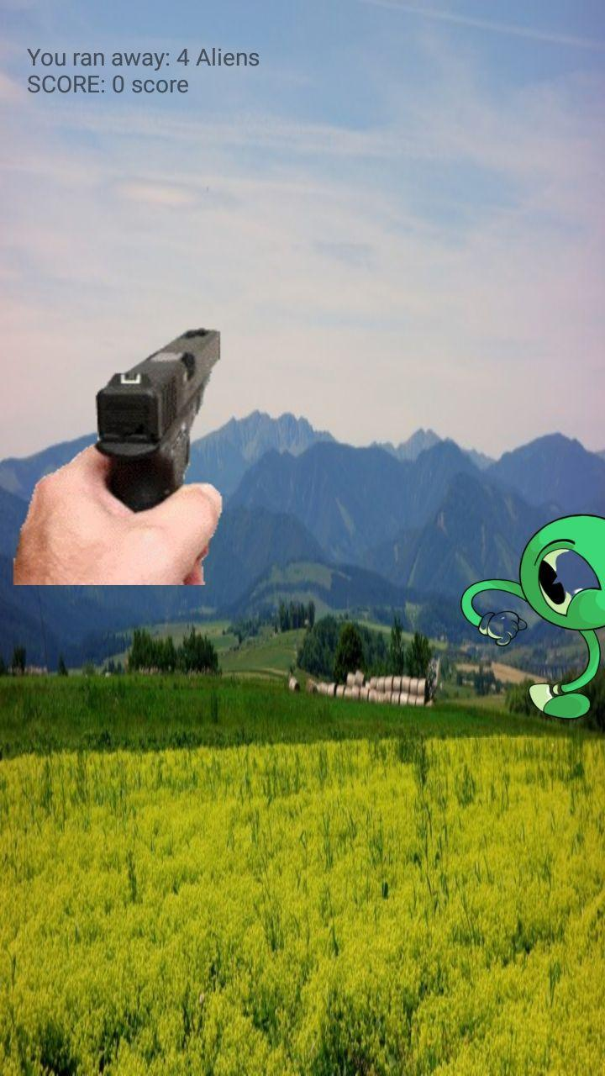
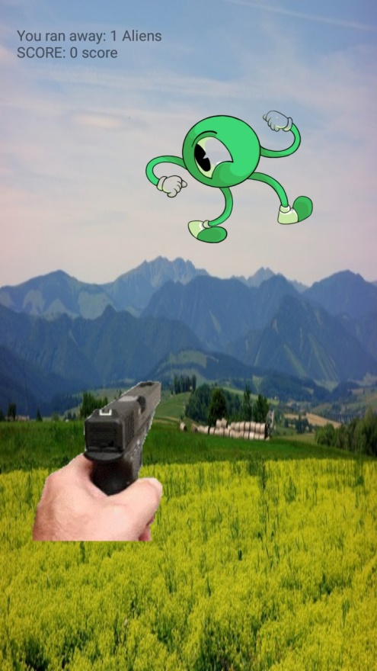
Motion Sensor
Player can score by targeting the alien by bringing the gun in front of alien with the help of motion sensor.
Alien is shot dead if it falls in this range.

Slide 8
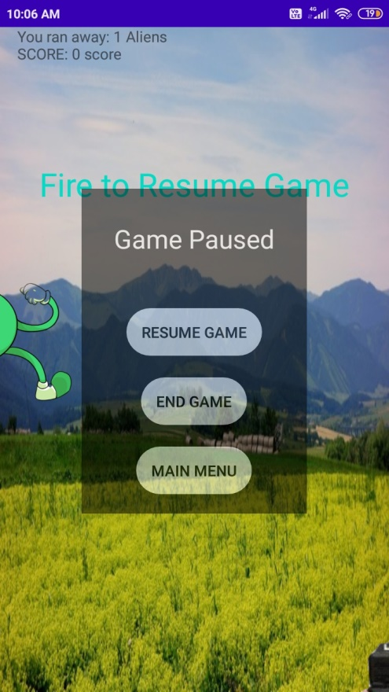
Popup Window
Popup Message is displayed if player presses Back Button while playing game.

Slide 9
Resume Game
Player do not looses his data like the Time Elapsed, Score and Lose Score on resuming the game.

Slide 10
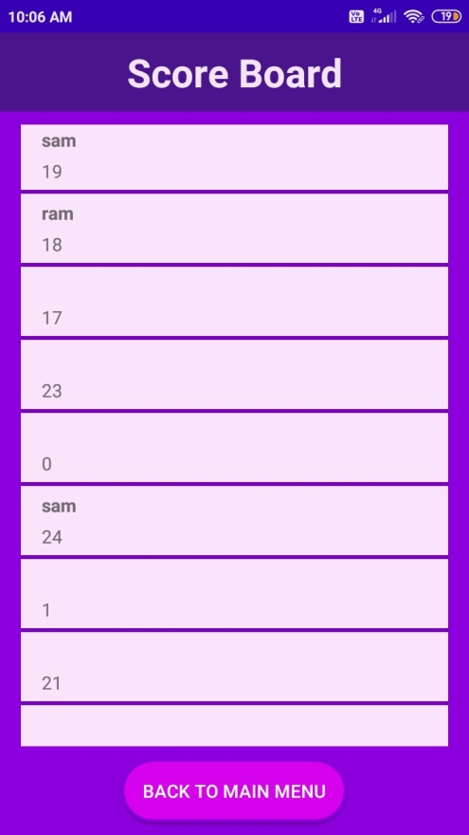
Custom List View
Array Adapter is used to populate the Custom List View. (Thus eliminating the need of View Holder used in Base Adapter)

Slide 11
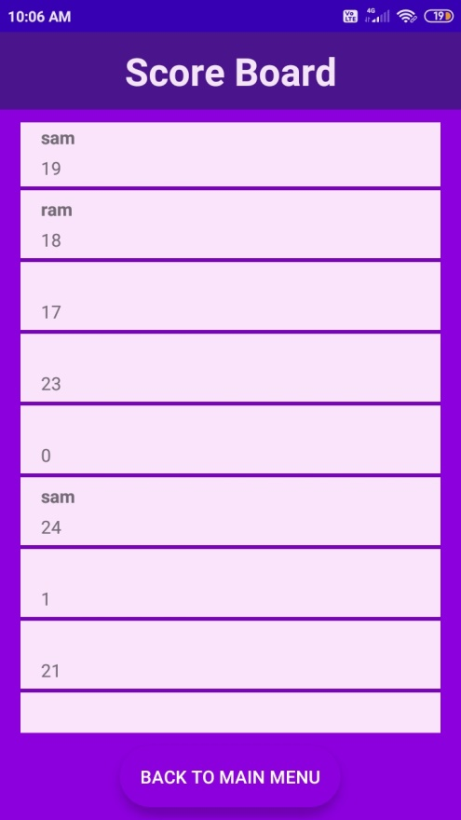
Material Design
Note the color changing behavior of customized back buttons.

Slide 12
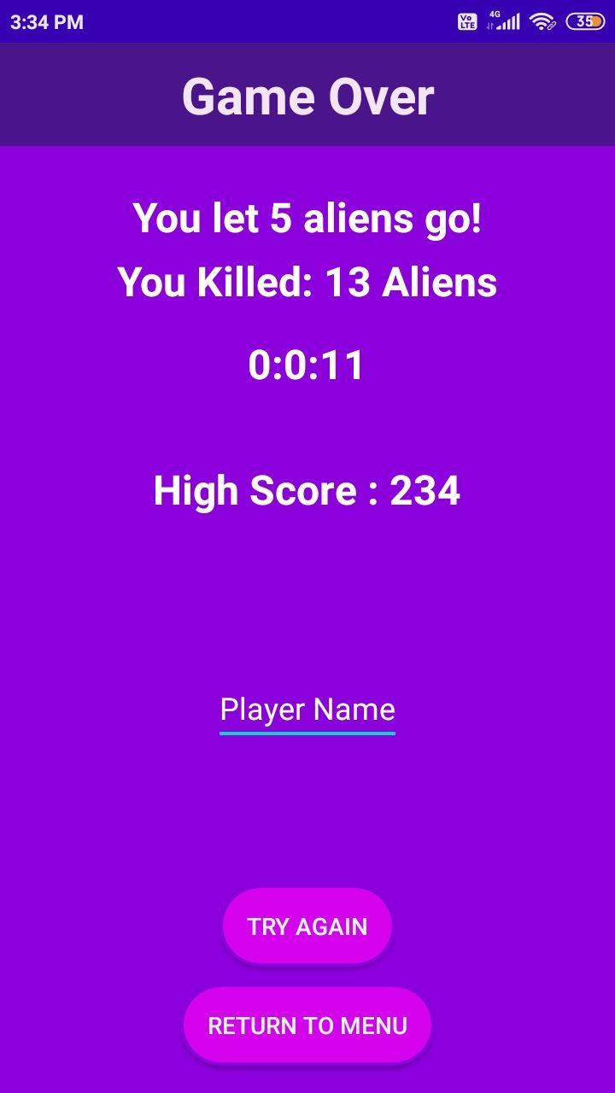
Play Time Duration
The Play time Duration is received by judicious use of System.currentTimeMillis
The Play time Duration can also be received with the help of a Bound Service.

Slide 13
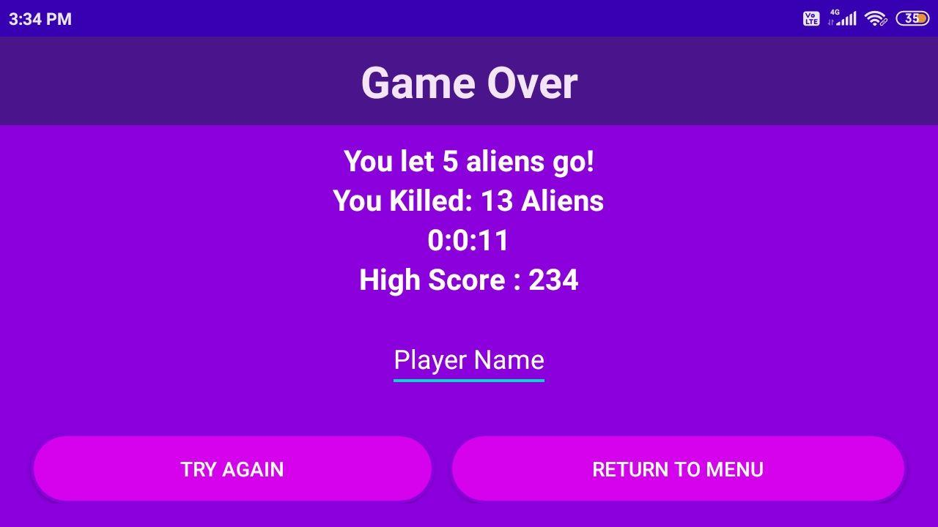
Orientation Optimization

Slide 14
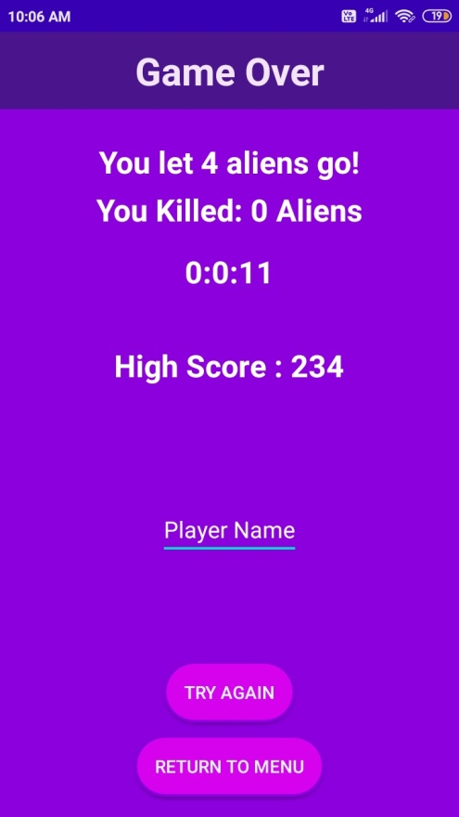
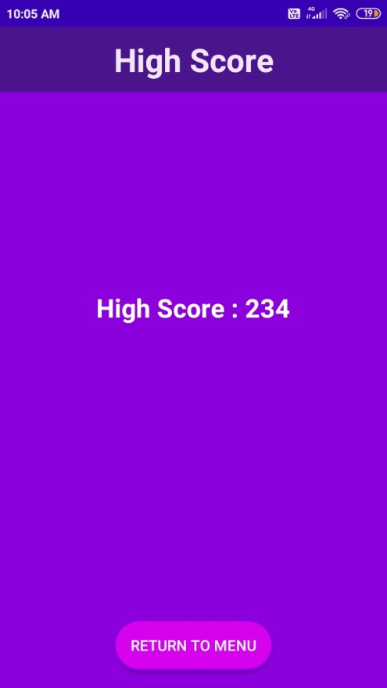
Game Logic
The Game Over Page has been optimized to show High Score by setting the visibility of different view elements accordingly.
The RETURN TO MENU button doesn’t saves the default value of Player Name and Score when pressed in High Score Page.

Slide 15
Thank You!!
Present by:
Sarvesh Mishra

